Slide 1
POWER ALLOCATION (Resources allocation of electricity)~ESKOM
MASHAU PHINDULO
216037211
CSC3A10 MINIPROJECT

Slide 2
Contents
Introduction
Goal
Problem
Solution
Implementation
Conclusion

Slide 3
Introduction
The project is about the smart power allocation strategy.
The smart power allocation strategy simplified the source(primary supplier) to - the main user problem over each secondary supplier to a source to -two -user problem.
In this case the two users become one main user.

Slide 4
Goal
Solve the eskom problem which is load shedding

Slide 5
Problem
The misuse of electric power due to unnecessary demands
The large capacity of electricity used causes the extra electricity cost which results in load shedding

Slide 6
Solution
Usage of graph to locate suppliers(power stations), users as well as the electricity cost
Nodes(vertices) represent power stations , transformers and the users
Edges represent the electricity cost
The graph traversals represent the path with the smallest cost
Therefore Main users and suppliers are connected by the electricity cost

Slide 7
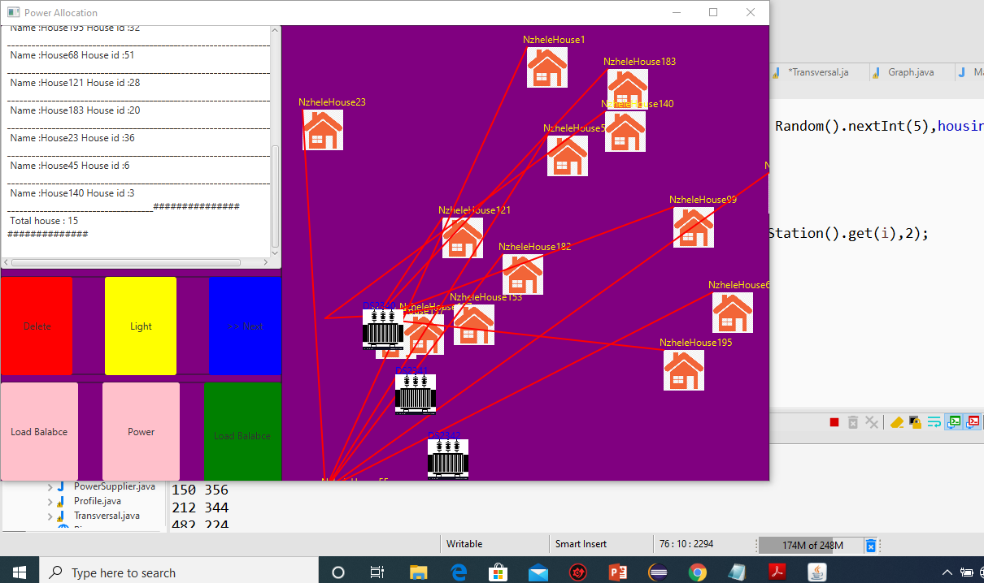
Implementations

Slide 8
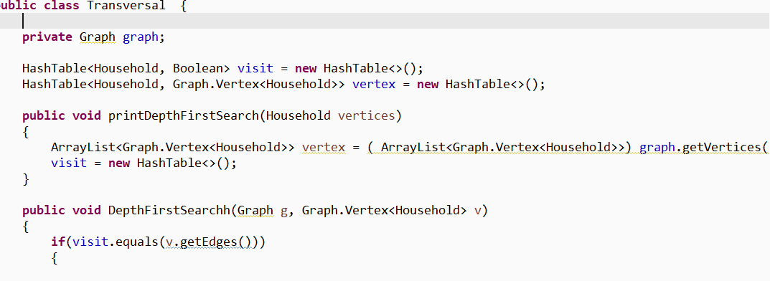
Depth first search traversal algorithm

Slide 9
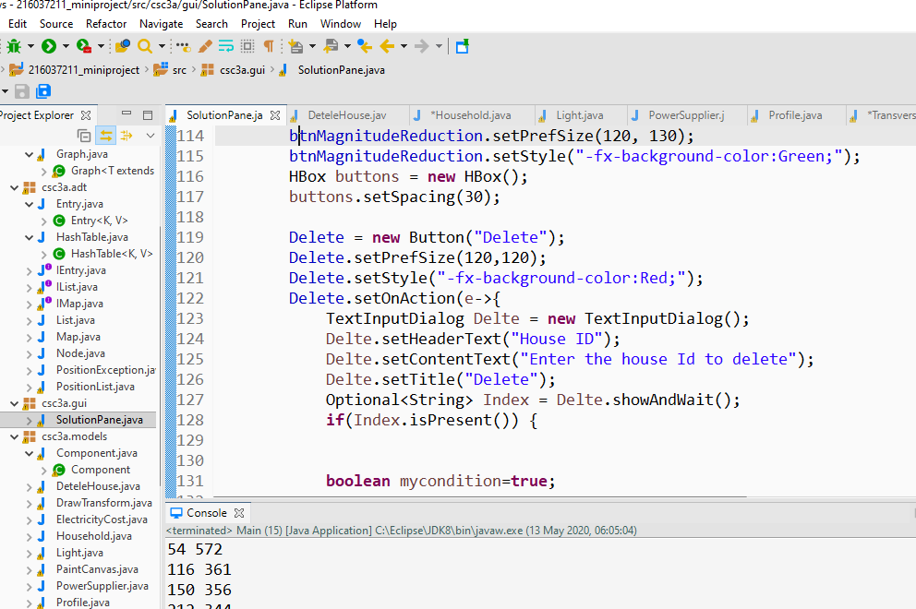
Delete node

Slide 10
Conclusion
Initially I had a challenge of visualizing the solution to the problem i.e implementing the solutions
This leads to the project no successfully achieved all the plans as stated
In conclusion : I have learnt that planning and working on time is the best way for the best productivity.
Thank you!

